Slide 1
ABC NBA Workforce Insights
A Comprehensive Data Analysis Report By Aneesh Murali Nariyampully

Slide 2
Introduction
ABC (American Broadcasting Company) – This is a major television network in the United States, part of the Disney family of networks. It broadcasts a variety of programs, including news, sports, and entertainment. ABC also airs sports, including some NBA games.
NBA (National Basketball Association) – This is a professional basketball league in North America, featuring some of the best players and teams in the world. The NBA consists of 30 teams and is one of the most popular sports leagues globally.
Upon completing the analysis of the NBA players dataset from ABC company, several key insights, trends, and correlations were identified. These insights can help the company understand its workforce distribution, salary expenditure, and potential factors influencing compensation. Here's a summary of the findings.

Slide 3
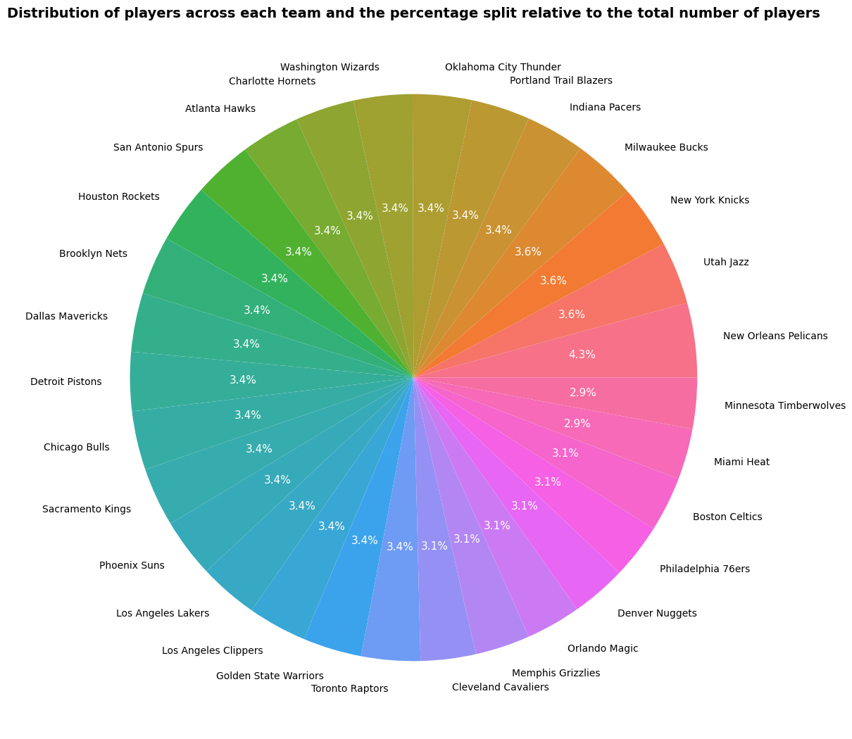
Key Findings and Insights:
Largest share: New Orleans Pelicans represent the largest percentage of employees, holding 4.3% of the total.
Teams with 3.6%: New York Knicks, Utah Jazz, and Milwaukee Bucks share a 3.6% allocation.
Teams with 3.4%: Many teams, including the Golden State Warriors, Los Angeles Lakers, Brooklyn Nets, Chicago Bulls, and others, have 3.4% of the total employee distribution.
Teams with smaller shares: Miami Heat, Boston Celtics, Philadelphia 76ers, Denver Nuggets, and a few others have smaller percentages, around 2.9%-3.1%.
Balanced Distribution: Most teams have an equal or near-equal player distribution, showing a balance across organizations with slight variations.

Slide 4
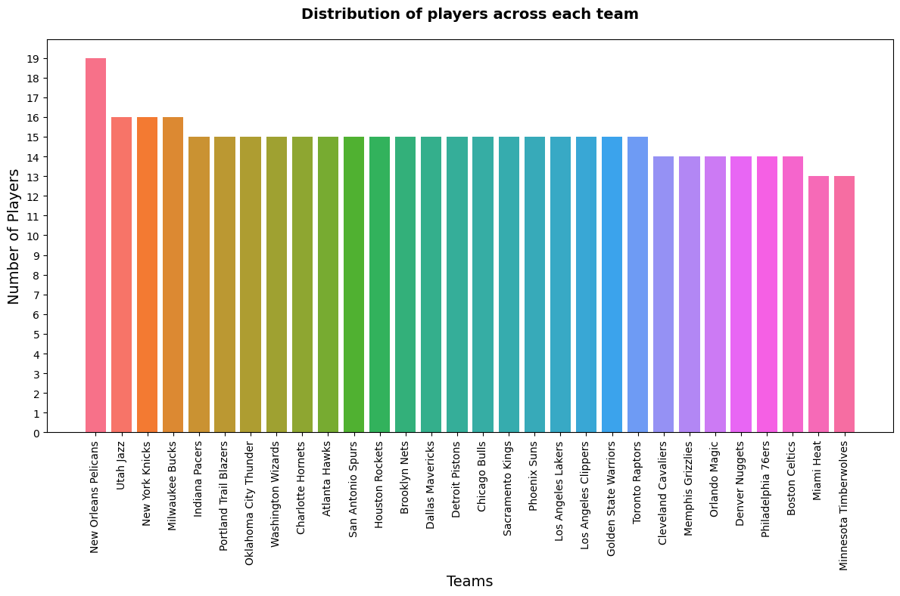
Key Findings:
Most teams have a similar number of players.
There are small differences in team size.
The New Orleans Pelicans is the largest team with 19 players.
The bar chart shows that most NBA teams have around 15 players. A few teams have slightly more or fewer players, but there's no single team with a significantly larger number of players than others. This suggests a relatively balanced league.

Slide 5
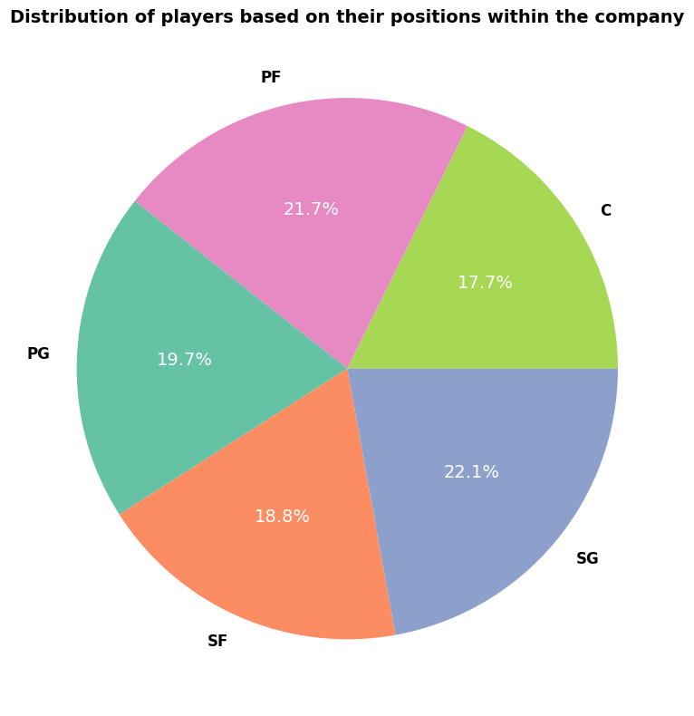
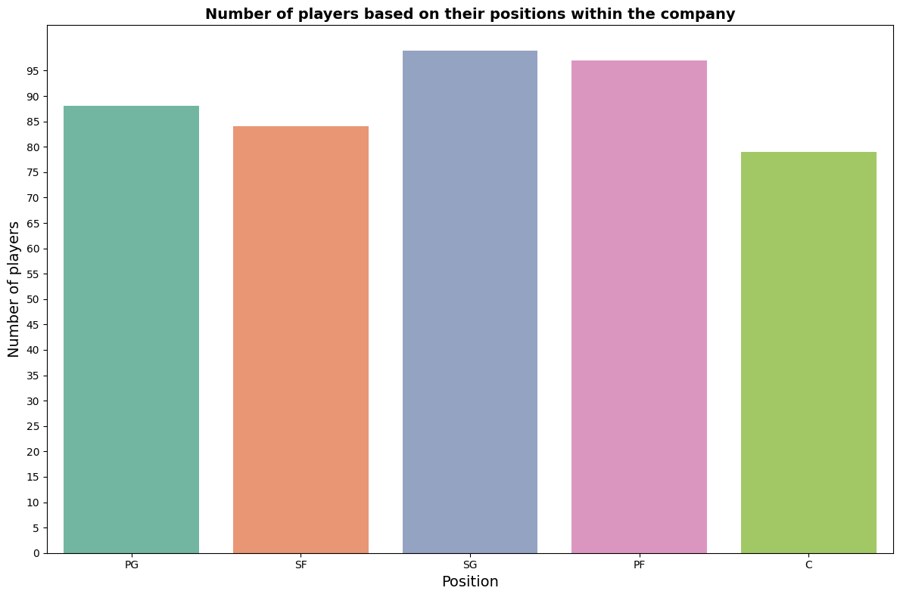
Point Guard (PG): 19.7%, Small Forward (SF): 18.8%, Shooting Guard (SG): 22.1%, Power Forward (PF): 21.7%, Center (C): 17.7%
The chart reveals a relatively balanced distribution of players across the five positions. No single position dominates, suggesting a well-structured team.
There are minor differences in the percentage of players for each position. Power Forward (PF) and Shooting Guard (SG) positions have slightly higher percentages, while the Center (C) position has a slightly lower percentage .
No Dominant Position: The chart does not show any single position with a significantly larger share of players. This indicates a diverse workforce where different roles are equally important.

Slide 6
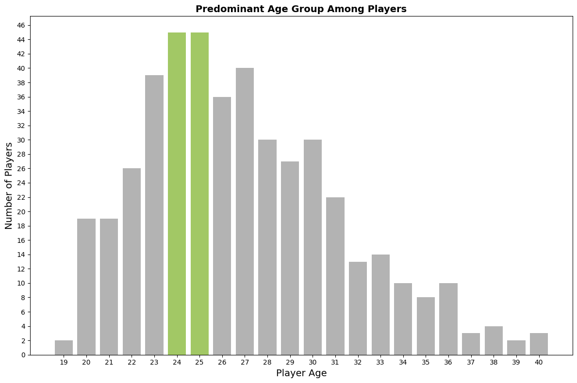
Key Findings:
Players in their early 20s (19–22) are fewer but still substantial. These are likely younger players, possibly new recruits or recent draft picks, still developing their skills.
The number of players begins to decline sharply after age 30. This suggests that veteran players, who may have significant experience but are possibly past their athletic prime, are fewer on the team.
The team has very few players above 35, likely due to the physical demands of the sport and the tendency to retire by that age.
The chart reveals interesting patterns about the age distribution of players. The majority of players fall within the 24–25 age range, which represents the peak of physical and athletic performance for basketball players. These ages are typically associated with players who have several years of professional experience, yet are still at the height of their physical prime.As we move away from this peak, the number of players decreases. Notably

Slide 7
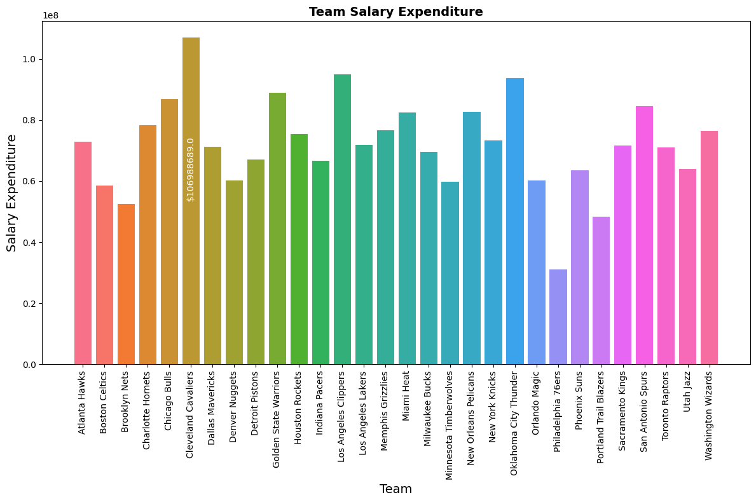
Highest Spender: The Cleveland Cavaliers have the highest salary expenditure, exceeding $106 million. This is marked directly on the chart.
Big Spenders: Several other teams also have very high salary expenditures, with the bars significantly taller than the rest. These teams include
Golden State Warriors
Los Angeles Clippers
Oklahoma City Thunder
San Antonio Spurs
Chicago Bulls
Mid-Range Spending: A large cluster of teams fall into a middle ground of salary expenditure, suggesting a general trend in league-wide spending.
Lowest Spenders: The Philadelphia 76ers and the Portland Trail Blazers seem to be among the lowest, with their bars being notably shorter.

Slide 8
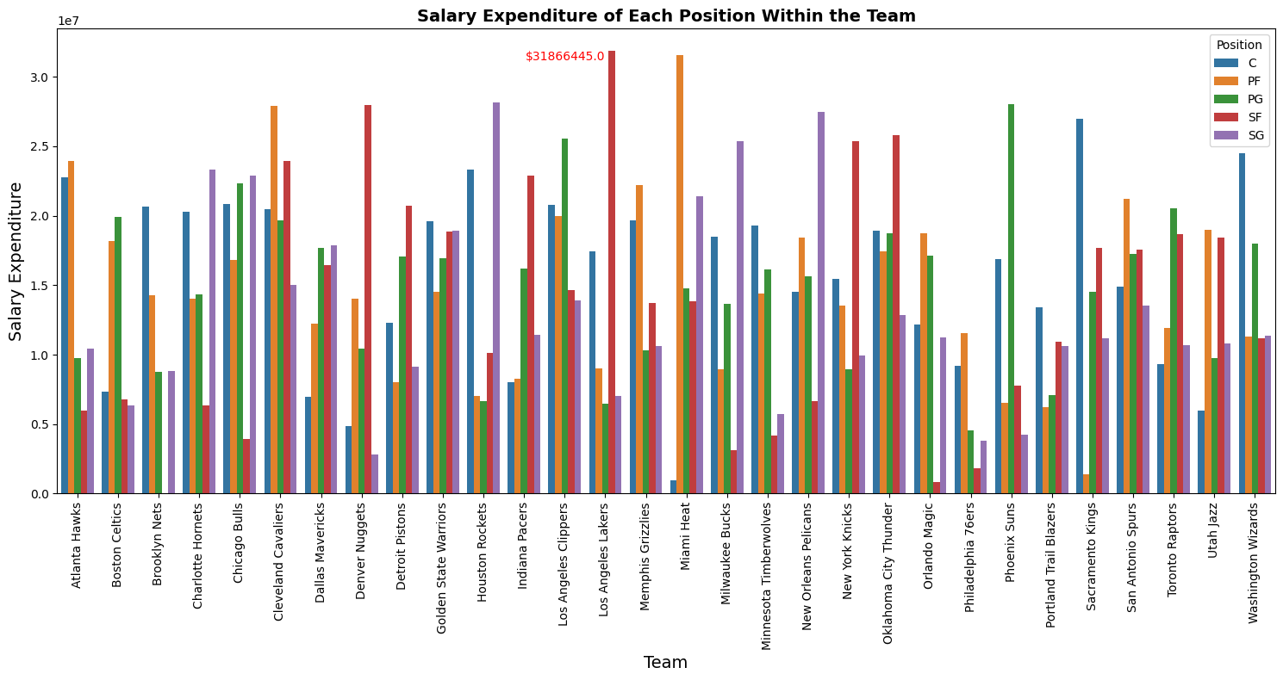
The Los Angeles Lakers are the only team with a single position exceeding $30 million. They spend over $31.8 million on Small Forwards (SF), which might indicate a reliance on a star player ‘Kobe Bryant’ or a strategic focus on that position. however Cleveland Cavaliers is highest spending team with a team salary expenditure over $106 million and the highest spending position within the team is Power Forward (PF)
Some teams, such as the Cleveland Cavaliers and Golden State Warriors, show more balanced salary allocations across positions, suggesting a more holistic team-building strategy.
Conversely, teams like the Brooklyn Nets and Los Angeles Lakers have more uneven spending, heavily investing in particular positions. This could indicate a reliance on a few key players to drive the team's performance.
The graph paints a picture of how NBA teams allocate their financial resources across player positions, providing insights into their strategies, strengths, and potential areas of focus. The emphasis on certain positions over others reveals how teams aim to optimize performance, whether by relying on individual superstars or building well-rounded squads. The Los Angeles Lakers, for instance, appear to be heavily invested in their Small Forward, while other teams like the Brooklyn Nets focus on multiple key positions, showing a diverse strategic outlook across the league.
The variation in salary distributions reflects the differing approaches in team-building, whether it's through balanced spending or focusing on key players.
Teams with a high salary in one or two positions may have superstars, while teams with a more even distribution may prefer depth and versatility.

Slide 9
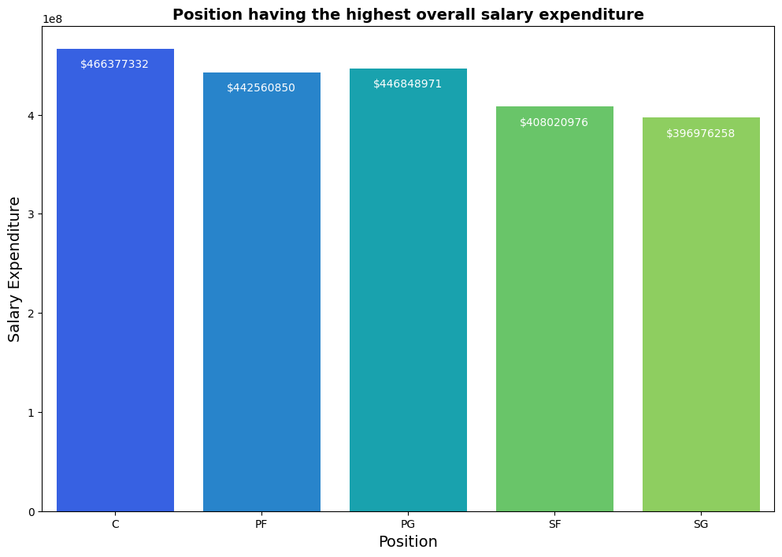
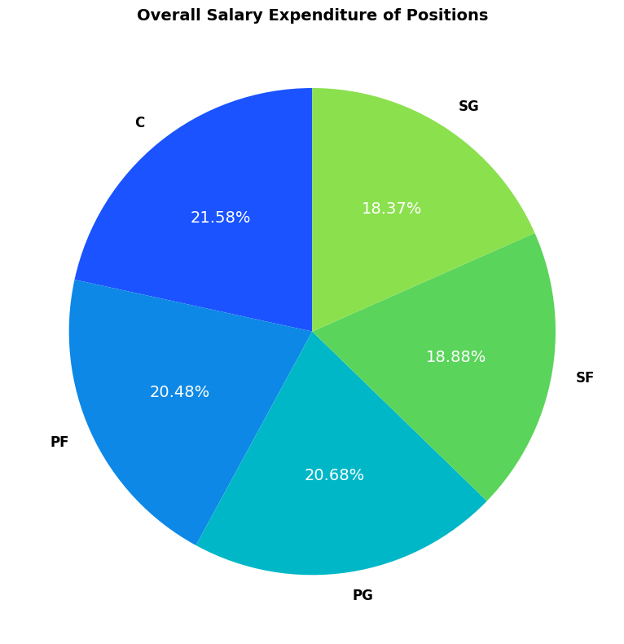
The chart reveals that the Center (C) position has the highest overall salary expenditure, surpassing all other positions. This suggests that teams are investing significantly in players at this position.
The remaining positions (Power Forward, Point Guard, Small Forward, and Shooting Guard) have relatively similar salary expenditures, with only minor variations.
There are no extreme outliers in the data, indicating a relatively balanced distribution of salary expenditures across positions.

Slide 10
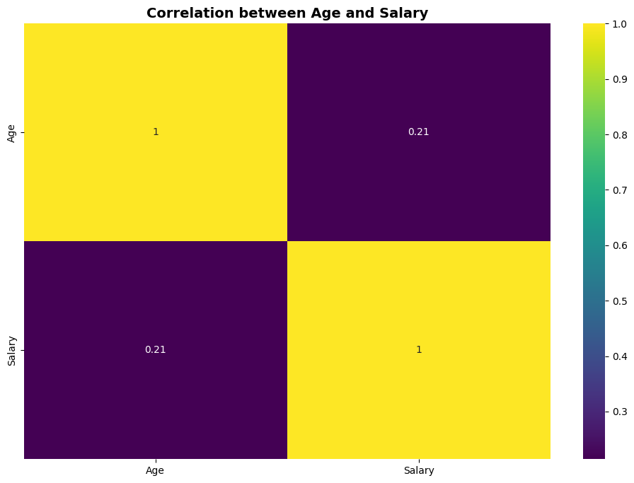
Weak Positive Correlation: The off-diagonal cell, representing the correlation between Age and Salary, shows a weak positive correlation of 0.21. This indicates a slight tendency for older players to have higher salaries.
The weak positive correlation suggests that NBA players may receive a slight premium for their experience. Older players with more years in the league might command higher salaries due to their accumulated knowledge and skills.
The correlation reflect the typical career trajectory of NBA players, where salaries tend to increase as players gain experience and establish themselves as key contributors.

Slide 11
Conclusion
Overall, the analysis reveals a relatively balanced league with teams adopting different strategies in terms of player distribution, salary expenditure, and positional spending. These insights can help the company understand its workforce distribution, salary expenditure, and potential factors influencing compensation, ultimately informing data-driven decisions to optimize performance and competitiveness.

Slide 12
Thank You

